Slide 1

AIML CA2 Part B – Student Segmentation
Randal Hong
DAAA/FT/1B/03
p2309248

Slide 2
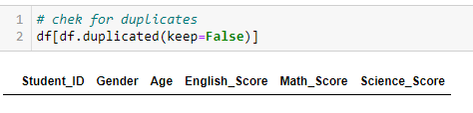
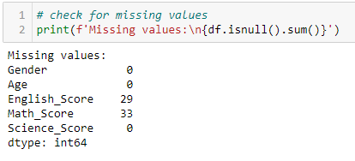
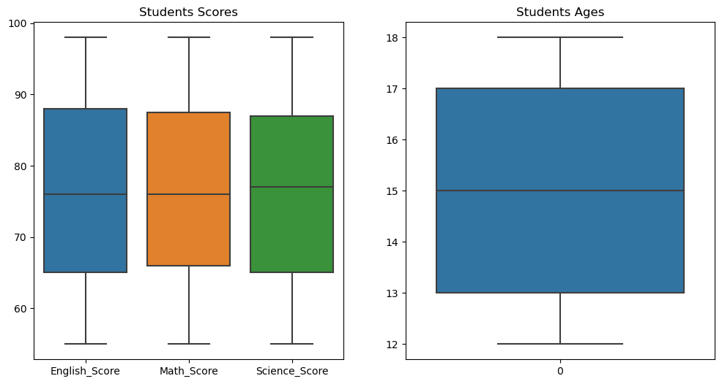
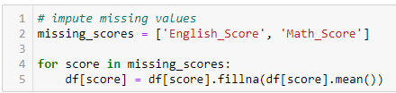
Data Preprocessing
Check for duplicative data
Check for missing values
View data distribution
Since the data has no outliers, we will impute using mean

Slide 3
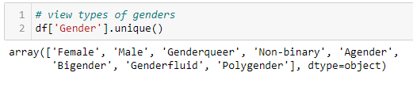
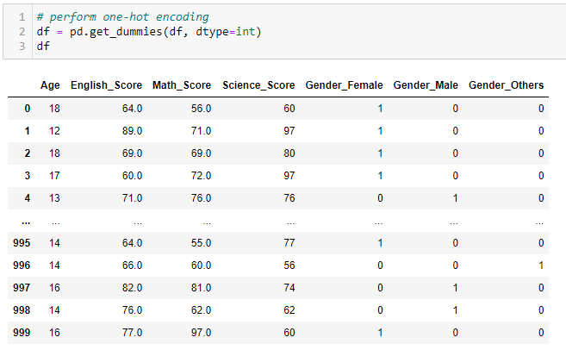
Data Preprocessing – One-Hot Encoding
As gender is a categorical data, we will need to one-hot encode it
As there are many different types of genders, to reduce the number of features the model has to process, we will categorise into 3 main genders: Male, Female and others

Slide 4
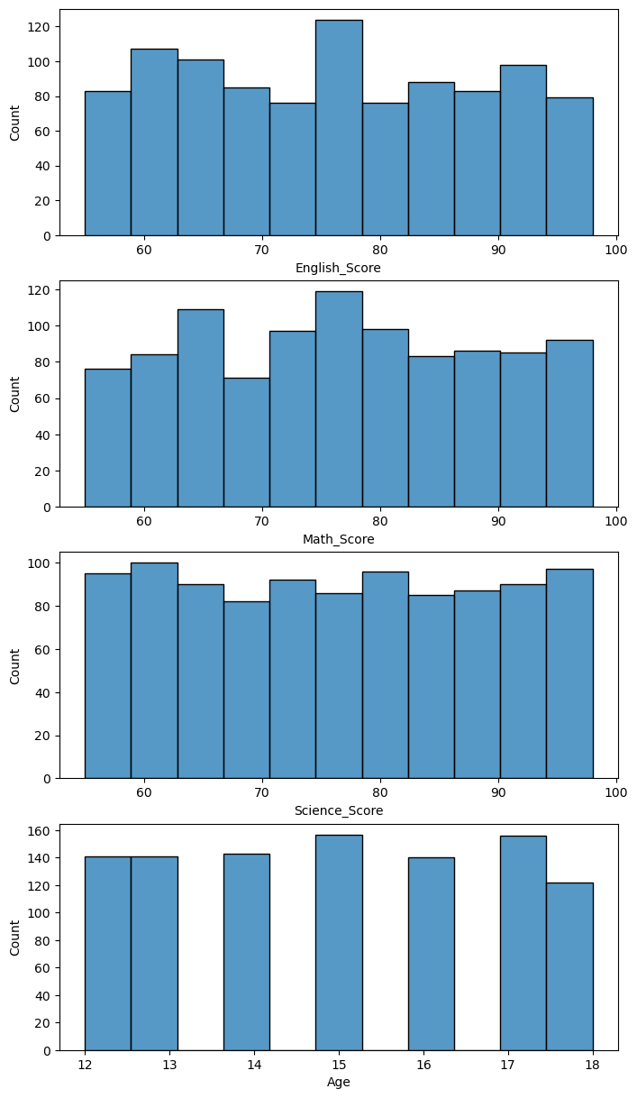
Data Preprocessing
As unsupervised models like K-Means clustering uses distance between data, scaling the data will make sure that all the data will be in a similar scale whereby one feature will not have a bigger impact than the others
As the scores are not normally distributed, we will use standardization as our method of scaling

Slide 5
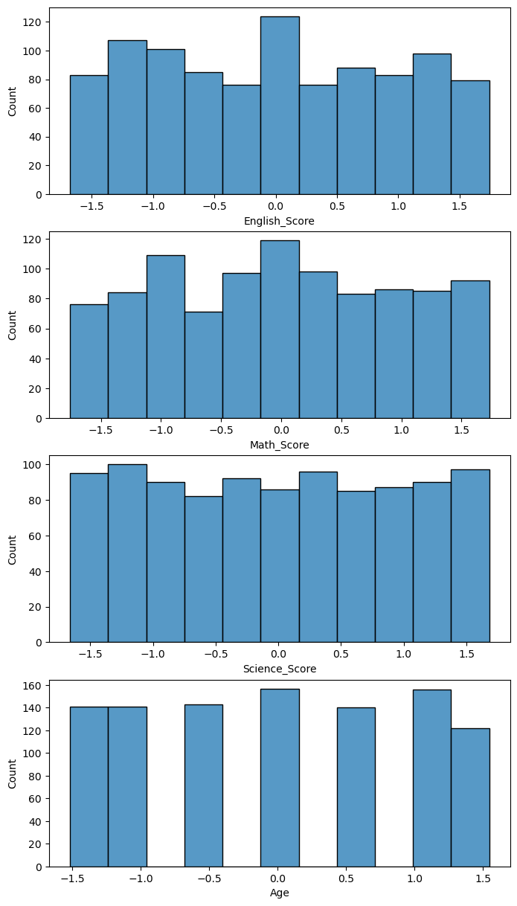
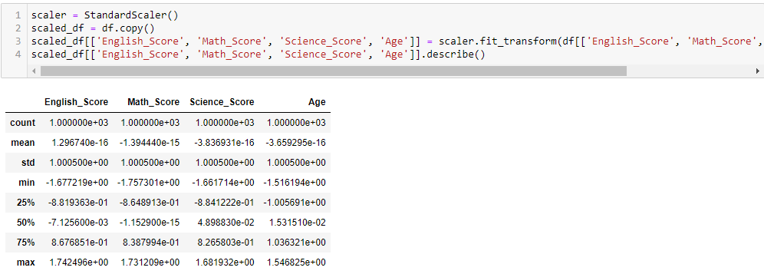
Data Preprocessing
Standard deviation is the same
Distribution of data has not changed

Slide 6
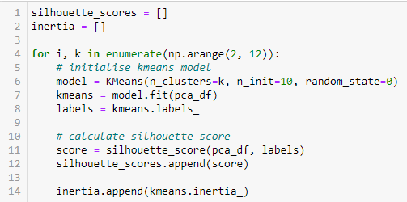
Model Selection
We can find the optimal k by using 2 methods:
Elbow method
Silhouette method
We will first get all the inertia and silhouette scores for each k value in KMeans

Slide 7
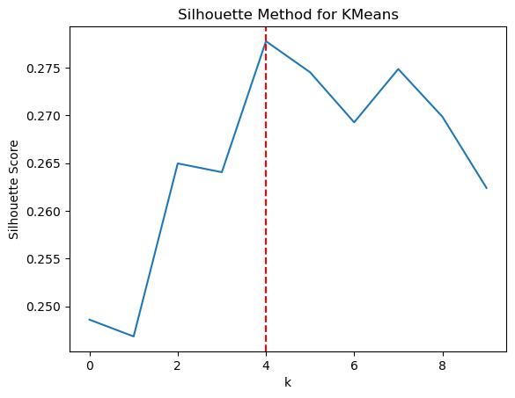
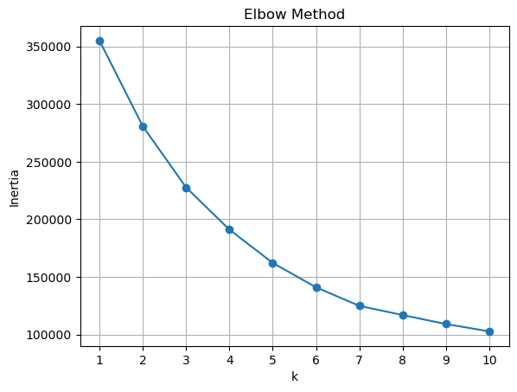
Model Selection
As there is no clear elbow in the plot, we will use the silhouette method
From the silhouette graph, we can conclude that the optimal k to use will be 4

Slide 8
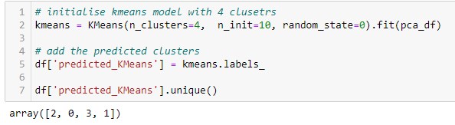
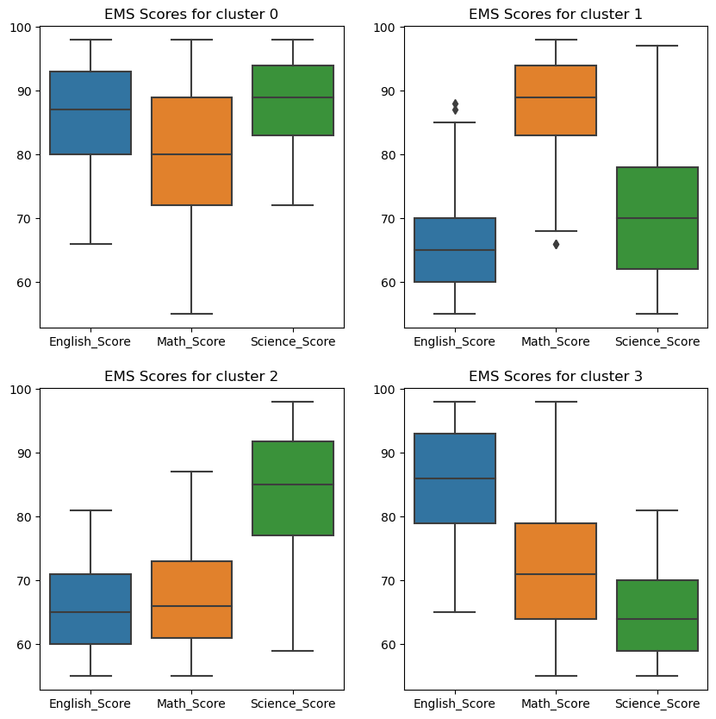
Model Building - KMeans
Initialise KMeans model with n_clusters of 4
Visualise the clusters
Cluster 0: Students with high scores for English, Math and Science
Cluster 1: Students with high scores for Math, average scores for Science and low scores for English
Cluster 2: Students with low scores for both English and Math but high scores for Science
Cluster 3: Students with high English scores, average Math scores and low Science scores

Slide 9
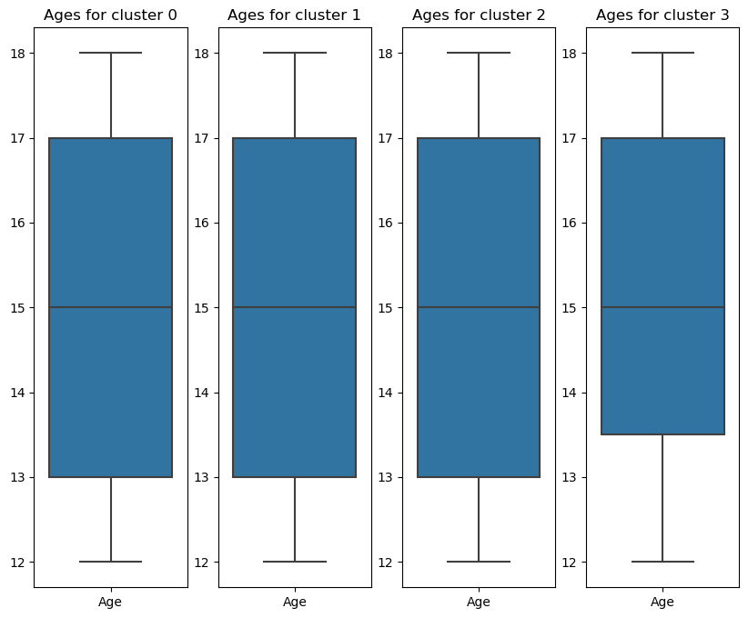
Model building - KMeans
Visualise the clusters
Cluster 0, 1 and 2: Students aged generally about 13-17
Cluster 3: Students aged generally about 14-17

Slide 10
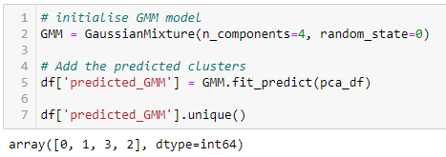
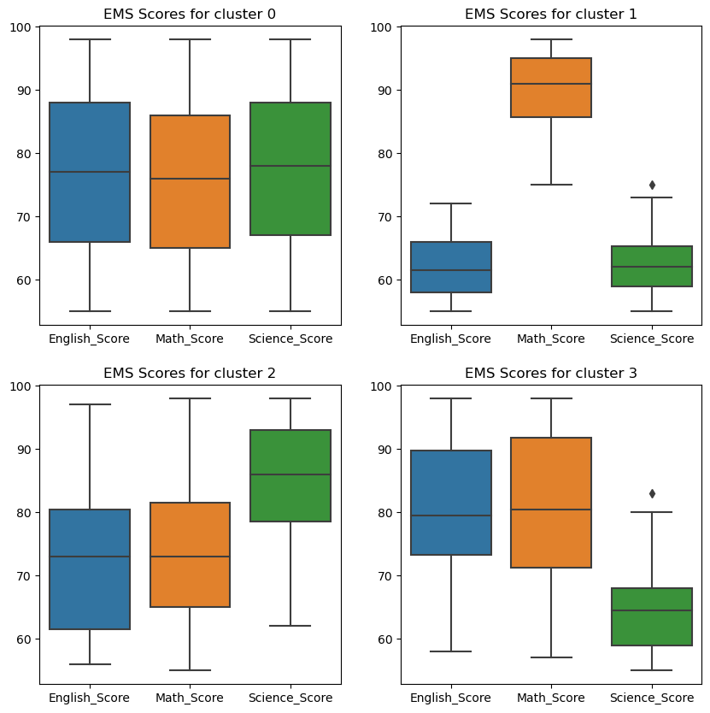
Model Building - GMM
Initialise GMM model with n_clusters of 4
Visualise the clusters
Cluster 0: Students with average scores for all subjects
Cluster 1: Students with high scores for Math but low scores for English and Science
Cluster 2: Students with high scores for Science and average scores for both English and Math
Cluster 3: Students with high scores for English and Math but low scores for Science

Slide 11
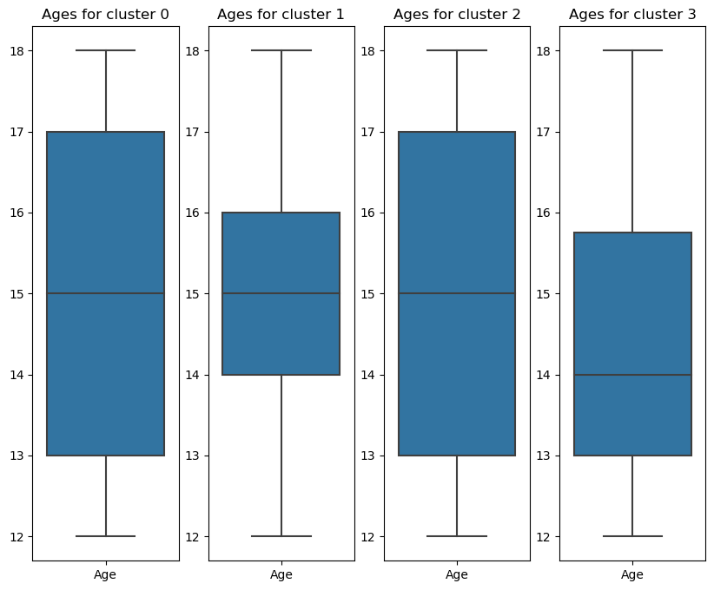
Model Building - GMM
Visualise the clusters
Cluster 0 and 2: Students aged generally about 13-17 years
Cluster 1: Students aged generally about 14-16 years
Cluster 3: Students aged generally about 13-15 years

Slide 12
Model Evaluation - KMeans
Generally, we can tell that:
Cluster 0 (academically inclined students):
Students across all ages
Relatively strong for all 3 subjects
Cluster 1 (students who need more help with English):
Students across all ages
Strong in Maths
Average in Science
Weak in English
Cluster 2 (students who are doing decently well):
Students across all ages
Strong in Science
Average in Math and Science
Cluster 3 (students who need more help with Science):
Students across all ages
Strong in English
Average in Math
Weak in Science

Slide 13
Model Evaluation - GMM
Generally, we can tell that:
Cluster 0 (students who are doing decently well):
Students across all ages
Average in all subjects
Cluster 1 (students who need more help with English and Science):
Mainly Secondary 2-4 students
Strong in Math
Weak in English and Science
Cluster 2 (Science students who are doing decently well):
Students across all ages
Strong in Science
Average in English and Math
Cluster 3 (students who need more help with Science):
Mainly secondary 1-3 students
Strong in English and Math
Weak in Science

Slide 14
Model Comparison and Conclusion
Both models show that Cluster 1 (secondary 2-4 students) require more help for English
Both models show that Cluster 3 (secondary 1-3 students) require more help for Science
KMeans focus more on the subject scores rather than age
GMM is quite balanced with age and subject scores

